Slide 1
A Speedy and robust Cryo-EM processing Platform (ASCEP)
Szu-Chi Chung

Slide 2
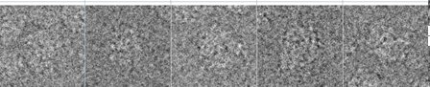
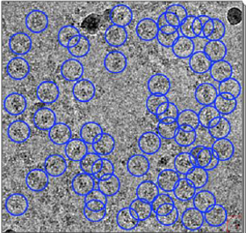
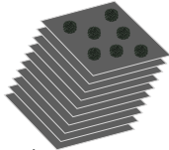
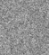

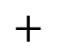
Cryo-EM Image Processing (1/3)
$$∗$$
$$+$$
Notes:
傳統電子顯微鏡技術對於生物樣本除了高能電子束的輻射傷害以外，還有為了避免電子被氣體分子干擾，樣本比需在真空狀態下進行測量，使得樣本呈現脫水 (dehydration) 的狀態。直到 1975 年，科學家成功的將樣本冷凍在一薄層的無序冰中 (amorphous or vitreous solid water)，奠定了 cryo-EM 的基礎。
https://investigatortw.wordpress.com/2015/02/26/%E7%B5%90%E6%A7%8B%E7%94%9F%E7%89%A9%E5%AD%B8-structural-biology-%E5%B0%88%E9%A1%8C/

Slide 3
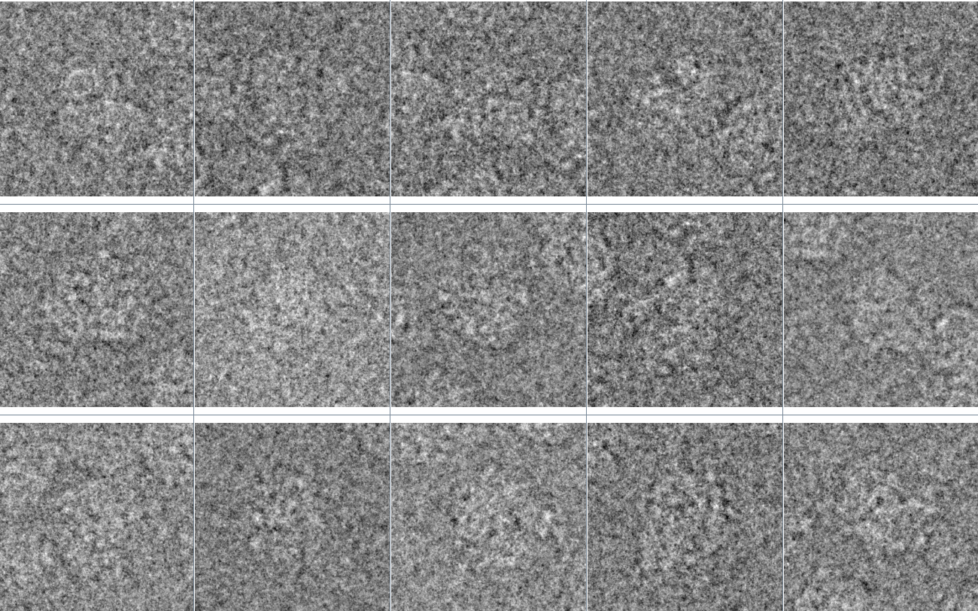
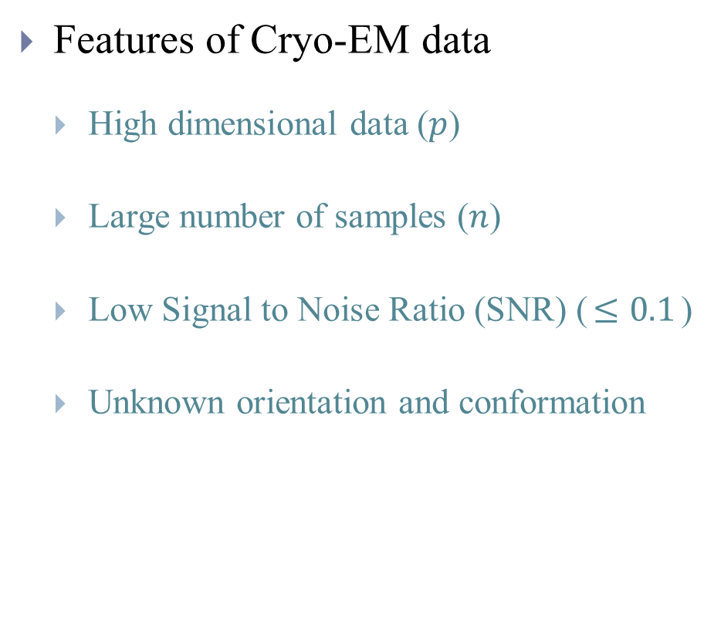
Cryo-EM Image Processing (2/3)
Features of Cryo-EM data
High dimensional data ($p$)
Large number of samples ($n$)
Low Signal to Noise Ratio (SNR) ($≤0.1$)
Unknown orientation and conformation
100
100
….
>100000
Notes:
The acquired image is further modulated by the CTF function
The data is mixture of conformation
Heterogeneity is another problem in Cryo-EM 3D determination

Slide 4
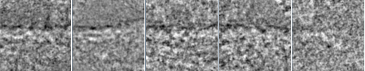
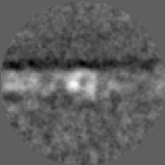
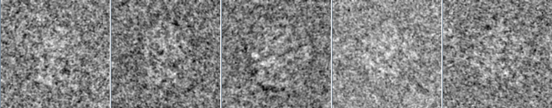
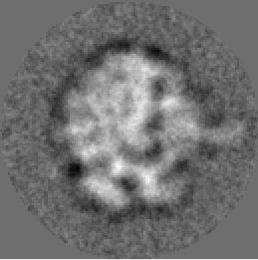
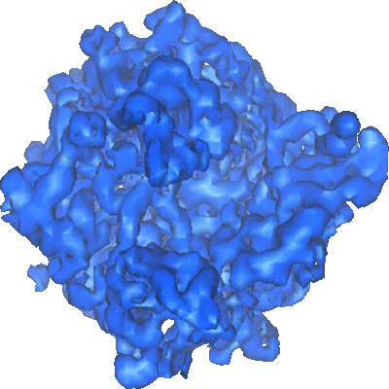
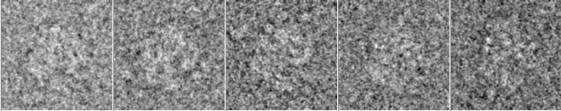
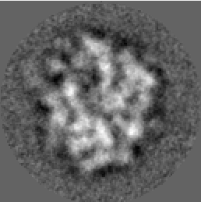
Cryo-EM Image Processing (3/3)
Alignment and Clustering

Slide 5
ASCEP

Slide 6
Cryo-EM Analysis Packages
http://3dem.ucsd.edu/software.shtm
Package | Strength/Breakthrough | Weakness
RELION | Very Inclusive and Adaptive 3D Classification | 2D Clustering
SPHIRE *(ISAC) | Particle picking 2D Clustering | Weak 3D Classification
CisTEM | Friendly GUI Interface | Weak 3D Classification
CryoSparc | 3D Reconstruction (SGD computation) | Weak 3D Classification
Notes:
40+ 400+
8 5x

Slide 7
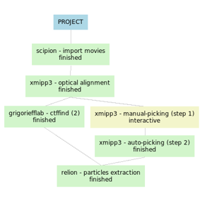
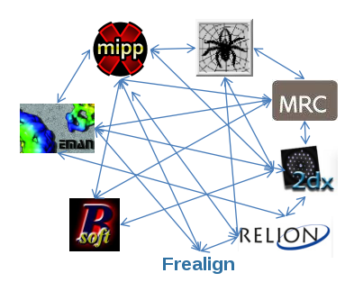
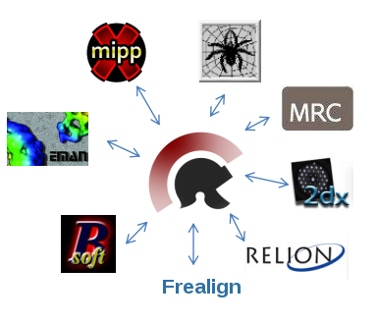
An Unified Framework for Cryo-EM (1/3)
Scipion - Integrate EM software packages
Provide conversion functions
Improve reproducibility
Workflow is organized as DAG
Notes:
and can be output as JSON format for exchanging purpose
database

Slide 8
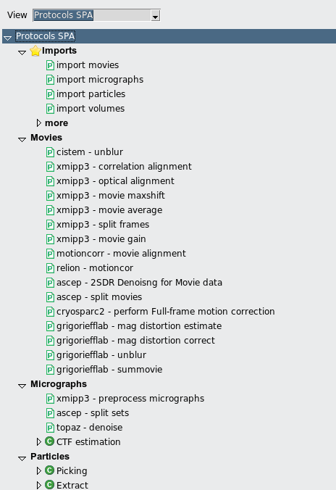
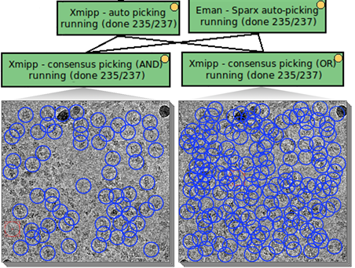
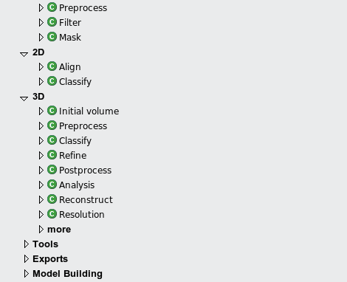
An Unified Framework for Cryo-EM (2/3)
Picking
Notes:
CTF – estimations must agree below certain resolution
Classes – intersection of assignment
Angular

Slide 9
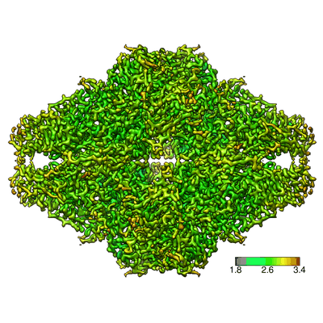
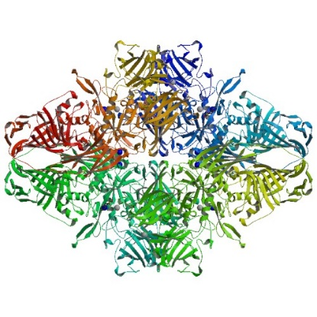
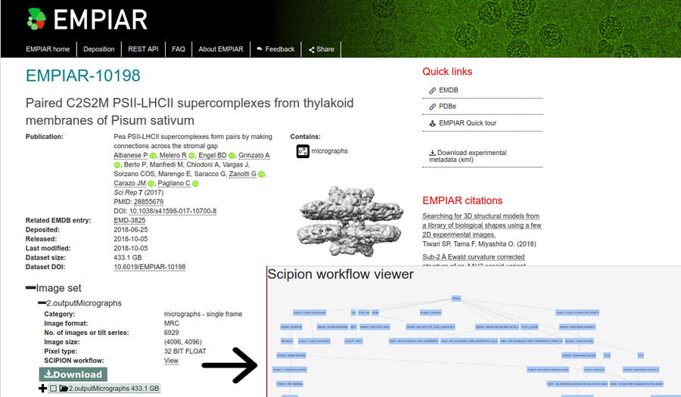
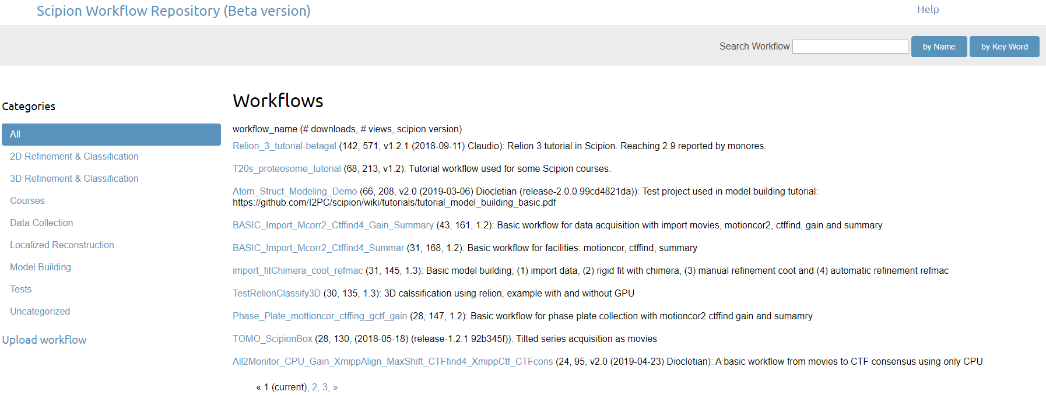
An Unified Framework for Cryo-EM (3/3)

Slide 10
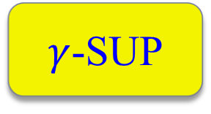
ASCEP: More than Scipion More Competitive Algorithms to Meet Current Challenges
DRMRA
DRMRA
ISAC
CryoSparc
2SDR
i-tSNE
Robust PCA
CNN
$γ$-SUP
PRIME
Still growing…
Model Bias

Slide 11
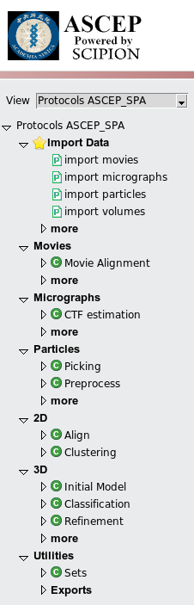
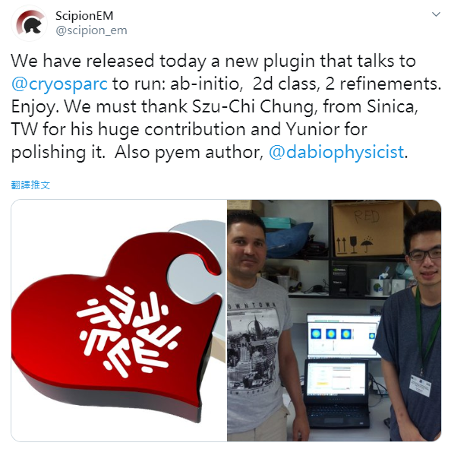
ASCEP Features
Statistical tools build by our team
Cleaner interface
The original interface contains a diversity of packages which
is hard for beginner to start with
State-of-the-art packages
CisTEM, RELION
CryoSparc, SPHIRE(ISAC)
Notes:
Additional packages:
Prime 3
EMAN2 for conversion
Xmipp3 for scipion

Slide 12
Two Stage Dimension Reduction (2SDR)

Slide 13
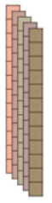
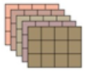
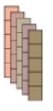


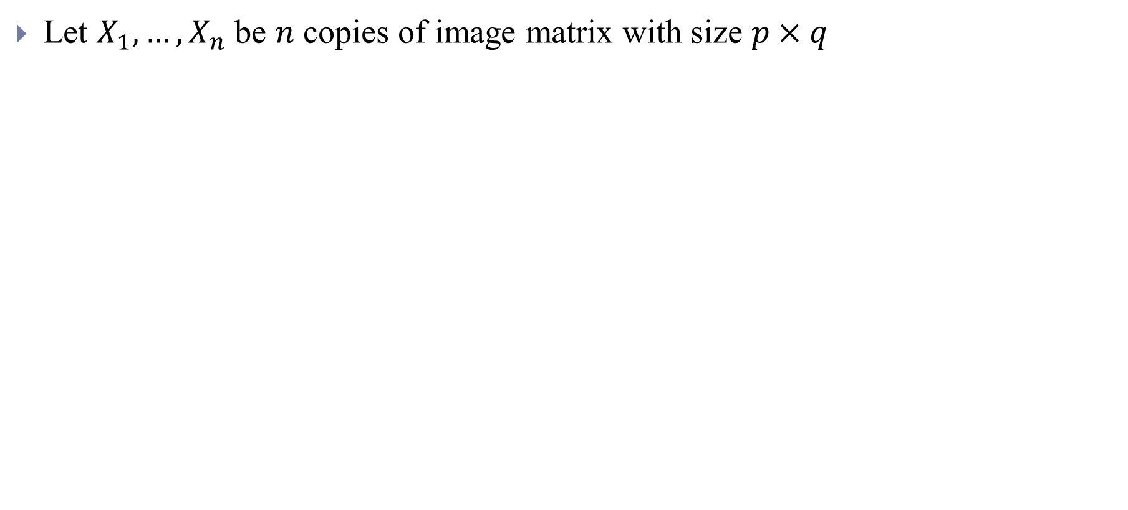

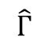

PCA on image data
Let $X_{1}, …,X_{n}$ be $n$ copies of image matrix with size $p×q$
$$pq×n$$
$$q$$
vectorize
PCA
$$p$$
$$r×n$$
$$\hat{Г}$$

Slide 14
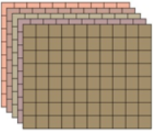


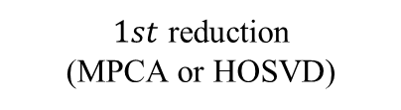


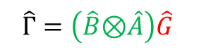


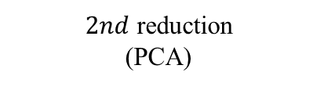
Proposed 2SDR on image data (1/2)
$$q_{0}$$
$$q$$
$1st$ reduction
(MPCA or HOSVD)
$$p_{0}$$
vectorize
$$p$$
$$\hat{Г}=\left(\hat{B}\text{⊗}\hat{A}\right)\hat{G}$$
$${p_{0}q}_{0}×n$$
$$r×n$$
$2nd$ reduction
(PCA)

Slide 15

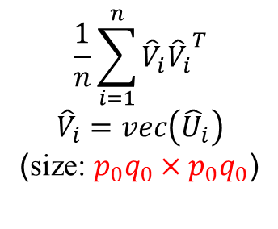
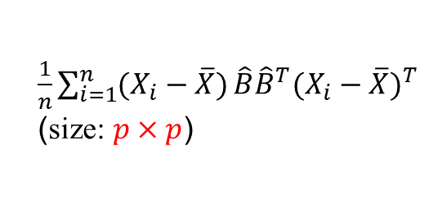
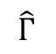
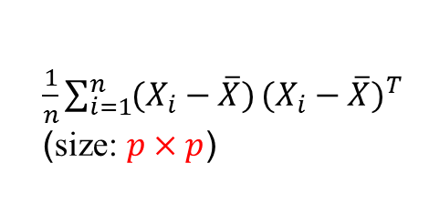


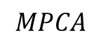
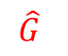

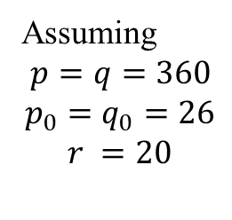





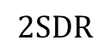
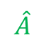
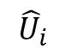
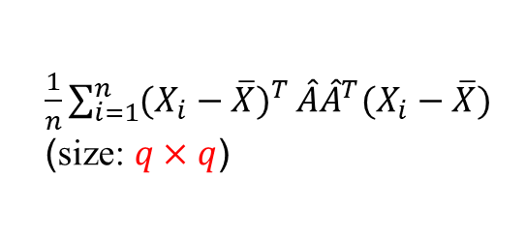
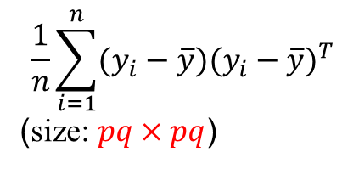
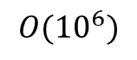
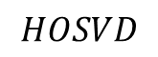

Proposed 2SDR on image data (2/2)
Solving eigenvectors of covariance matrix with size $m×m$ is $O(m^{2}r)$
$$HOSVD$$
$$MPCA$$
$\frac{1}{n}\sum_{i=1}^{n}{(X_{i}−\overline{X})}{(X_{i}−\overline{X})}^{T}$
(size: $p×p$)
$\frac{1}{n}\sum_{i=1}^{n}{(X_{i}−\overline{X})}\hat{B}{\hat{B}}^{T}{(X_{i}−\overline{X})}^{T}$
(size: $p×p$)
$$\frac{1}{n}\sum_{i=1}^{n}{{\hat{V}}_{i}{{\hat{V}}_{i}}^{T}}$$
$${\hat{V}}_{i}=vec\left({\hat{U}}_{i}\right)$$
(size: $p_{0}q_{0}×p_{0}q_{0}$)
Assuming
$p=q=360$
$$p_{0}=q_{0}=26$$
$$r =20$$
$\frac{1}{n}\sum_{i=1}^{n}{{(X_{i}−\overline{X})}^{T}}\hat{A}{\hat{A}}^{T}(X_{i}−\overline{X})$
(size: $q×q$)
$\frac{1}{n}\sum_{i=1}^{n}{{(X_{i}−\overline{X})}^{T}}(X_{i}−\overline{X})$
(size: $q×q$)
$${\hat{U}}_{i}$$
$$q$$
$$2SDR$$
$$p$$
$$q_{0}$$
$$p_{0}$$
$$O({10}^{6})$$
$$\hat{A}$$
$$\hat{B}$$
$$\hat{G}$$
$$\hat{Г}$$
$$q$$
PCA
$$p$$
$$\frac{1}{n}\sum_{i=1}^{n}{(y_{i}−\overline{y}){(y_{i}−\overline{y})}^{T}}$$
(size: $pq×pq$)
$$O({10}^{11})$$

Slide 16













Synthetic Data
Uniform project 3D map to 50 orientations to obtain 50 projected images
Duplicate each projected images 100 times
Convoluted each images with CTF functions
Add i.i.d Gaussian Noise to the 5000 images
Perform PCA, MPCA, 2SDR with
$p =130, q =130, n=5000, { p}_{0}=25, { q}_{0}=25, r=20$
3D structure
2D particle image
Independent, Gaussian distributed noise
$$∗$$
$$+$$
Projection/Slice Operator
Notes:
with defocus ranging from 1.5um-2um, voltage 300ev, astigmatism angle 0.2-1.4 radian, Cs=2

Slide 17

Synthetic Data – 70S Ribosome
Original
Noisy
PCA
MPCA
2SDR
SNR
SNR=0.1
SNR=0.05
SNR=0.01

Slide 18

Real data application – Particle images
Dataset: 70s Ribosome ($p =130, q =130, n=5000$)
Parameters
${ p}_{0}=25, { q}_{0}=25, r=20$
Original
PCA
MPCA
2SDR
Notes:
Pruning
Angular assignment
Check angular assignment

Slide 19


Real data application – Particle images
Dataset: 80s Ribosome ($p =360, q =360, n=105247$)
Parameters
${ p}_{0}=26, { q}_{0}=26, r=20$
Original
PCA
MPCA
2SDR

Slide 20



Real data application – Particle images
Dataset: Betagal ($p =256, q =256, n=$5090)
Parameters
${ p}_{0}=80, { q}_{0}=80, r=20$
PCA
2SDR

Slide 21




Real data application – Movie files
Dataset: Betagal ($p =1950, q =1950, n=16$)
The contrast enhancement is further applied
(a) Original Frame
(b) PCA
(c) 2SDR

Slide 22
Short Summary
2SDR has several advantage
Computation cost is less than PCA
Performs better than PCA when SNR is low or sample size is small
2SDR (More efficient and better in some aspect)
HOSVD + RPCA
PCA + t-SNE
Notes:
FFT + PCA
General tool for image dataset in contrast to
Steerable PCA
Deep learning method

Slide 23
2SDR Preprocessing

Slide 24

Alignment and averaging
Reference-based alignment
Use correlation function as the measure
CCC: Cross Correlation Coefficient
CCf: Cross Correlation Function
Notes:
The algorithm is not guaranteed to converge to a global optimum
Outliers have a very negative impact on the outcome
The possibility of “group collapsing”, i.e., the possibility of a group loosing its members to the point of vanishing
If the number of groups is not guessed correctly and the groups are not well separable (which is always the case for very noisy data), the result depends dramatically on the initialization.
The algorithm is presented with K templates. In 3D MRA, for example, these can be K plausible structures of the complex obtained by some means earlier in the project. Either K randomly selected objects from the entire set are used as initial templates or all objects are randomly assigned to K classes such that each class has the same number of objects and within-group averages are used as initial templates.

Slide 25




Noise reduction before alignment
Transform
Orientation
parameters
CCC
2SDR
CCC
Orientation
parameters
Reference-Based
Alignment

Slide 26



















Noise reduction before alignment
Using Dataset 1
21 most correlated images are averaged using original data
Reference
Transform
Without 2SDR
Orientation
parameters
CCC
2SDR
Orientation
CCC
parameters
Reference-Based
Alignment
With 2SDR
Notes:
It will be helpful in alignment

Slide 27
Short Summary
2SDR-Pre
Use low frequency information from 2SDR denoised particles for better alignment
Change the initial condition without loss of high frequency component
2SDR-Pre
Increase high quality class averages of 2D clustering algorithm
Reduce the computation time
Notes:
General tool for image dataset in contrast to
Steerable PCA
Deep learning method

Slide 28
Visualization

Slide 29

t-SNE (1/2)
First tool that can clearly separates MNIST dataset
Random partition t-SNE to handle large dataset
Notes:
cuml

Slide 30






t-SNE (2/2)
Apply to different stage in the CryoEM workflow
Visualize classification results

Slide 31

Interactive t-SNE (1/2)
Interactive t-SNE
Fine tune the clustering results

Slide 32



Interactive t-SNE (2/2)
Find more views and conformations
Results of CL2D
After interactive t-SNE

Slide 33
Distributed Robust Multi-Reference Alignment (DRMRA)

Slide 34

Multi-Reference Alignment
The particles are classified using PCA + k-means clustering
Class averages are calculated
Class averages are aligned
All the particles are aligned using class averages as reference
Alignment parameters are applied to obtained a new aligned image series
Steps 1-4 are repeated a prescribed number of times
4
3
1
2
Notes:
From https://spider.wadsworth.org/spider_doc/spider/docs/align.html

Slide 35
Distributed Robust Multi-Reference Alignment (DRMRA)(1/5)
Apply 2SDR- preprocessing and partition the data if # of images is large
The particles are classified using 2SDR + r-SUP
Class averages are calculated and combine similar class average using r-SUP
All the particles are aligned using class averages as reference
Alignment parameters are applied to obtained a new aligned image series
Steps 2-5 are repeated a prescribed number of times
(Optional) Split the class average which has cluster size larger than 1000 using K-means
Notes:
Spider and Sparx
Using its own rotational average as a reference, the particle is shifted, its new rotational average is formed and used as a reference, until no further shift is possible
The alignment includes rotational alignment, shift alignment, and a check of mirrored orientation.
Rotational alignment is done using the AP MD operation and is separated from the shift alignment. Shift is corrected using the most similar image (as determined by AP MD) as a reference.

Slide 36
Distributed Robust Multi-Reference Alignment (DRMRA)(2/5)
Step 4 class number set to 80 and binning the particles from 360 to 90 pixels
Algorithm | Execution Time (Hour) | MPI
1 | 0.17
2 | 0.5
3 | 0.02
4 | 1.3 | 44
5 | 0.25
7 | 0.08
 | 0.25+2.07n
Notes:
Currently transfer and loading data into different format will take about another 1~2 hour

Slide 37












Distributed Robust Multi-Reference Alignment algorithm (DRMRA) (3/5)
More robust in terms of t-SNE results (70S Ribosome)
Notes:
compare with state-of-the-art algorithm

Slide 38
Distributed Robust Multi-Reference Alignment algorithm (DRMRA) (4/5)
More robust in terms of t-SNE results
The computation time is reduced (80S Ribosome, 100K particles)
Algorithm | Iterations | MPI/GPU | Execution Time (Hour)
ISAC | Until convergence | 44/0 | 124.5/105.35
RELION | 25 | 4/3 | 32.65/29.85
DRMRA | 3 (is good enough) | 44/0 | ~5
Notes:
compare with state-of-the-art algorithm

Slide 39









Distributed Robust Multi-Reference Alignment algorithm (DRMRA) (5/5)
More robust in terms of t-SNE results
The computation time is reduced
Find more conformations (GS Protein from ASCEM, thanks to Professor Kuen-Phon, Wu)
Notes:
compare with state-of-the-art algorithm

Slide 40
Alignment by Moment of Inertia

Slide 41






Moment of Inertia (1/2)
The two-dimensional Cartesian central moment, $μ_{pq}$, of order $p+q$ for a $N×M$ discretized image $I(x,y)$ is
$$μ_{pq}=\sum_{y=0}^{M−1}{\sum_{x=0}^{N−1}{({x−\overline{x})}^{p}({y−\overline{y})}^{q}I(x,y)}}$$
The two-dimensional moment of inertia is defined as follows:
The eigenvectors correspond to major and minor axis of the image

Slide 42




Moment of Inertia (2/2)
Mirror and rotation by ${180}^{°}$ can’t not be differentiate
Use Frobenius norm of the average image as the criterion
$${\left\|\sum_{i=1}^{N}{I_{i}(α_{i}, x_{i},y_{i})}\right\|}_{F}$$

Slide 43





Moment of Inertia - Algorithm
Compute the covariance matrix $I$
(Optional) Using denoised particle instead
Solve the eigenvectors to get the major and minor axis
Align the major axis of all images to $x$ axis
Fine-tune
For each image check whether rotation by ${180}^{°}$ will increase the Frobenius norm or not
For each image check whether mirror about $y$ axis will increase the Frobenius norm or not
(Optional) Feed into RFA or other alignment algorithm to fine tune the results
Frobenius norm
$$\sim 12s$$
$$\sim 140s$$
Synthetic Betagal
$$p =130, q =130, n=5000$$

Slide 44






















Synthetic data - Betagal
Original
MoI
MoI_rf
MoI_drf
RFA

Slide 45

Real data application - 70S Ribosome
MoI with RFA 5 iterations
1.3s (denoise) + 5.7s(MoI) + 3.5s(Mirror) + 0.7s(Flip) + 79s (32 threads) = 90.2s
RFA 10 iteration
148s (32 threads)
Speedup 1.6~1.7x
Frobenius norm
Notes:
70S Ribosome

Slide 46

Real data application - 80S Ribosome (Bin 4)
MoI with RFA 5 iterations
40.5s (denoise) + 42.5s(MoI, 10 threads) + 36.6s(Mirror) + 8.8s(Flip) + 710s (32 threads) = 838.4s
RFA 10 iteration
1297s (32 threads)
Speedup 1.5~1.6x
Frobenius norm

Slide 47

Conclusion
A speedy platform that include state-of-the-art packages are proposed
High dimensional data (p)
Large number of samples (n)
Low Signal to Noise Ratio (SNR) (≤0.1)
Unknown orientation and conformation
It includes several useful tools developed from our team
Dimension reduction - 2SDR
Preprocessing – 2SDR-Pre
Validation – Interactive t-SNE
Clustering – $γ$-SUP, DRMRA
Alignment – Moment of Inertia

Slide 48
References
[1] Chung, S.-C., Niu, P.-Y., Huang, S.-Y., Chang, W.-H. and Tu, I.-P. “2SDR: Applying Kronecker Envelope PCA to denoise Cryo-EM Images”. (2019). arXiv:1911.09816[eess.IV]
[2] Chung, S.-C., Lin, H.-H., W.-H. and Tu, I.-P. “2SDR-Pre: a Fast Pre-processing Tool to Enhance Performance of 2D Clustering of Cryo-EM Images”. In preparation.
[3] Chen, T.-L., Hsieh, D.-N., Hung H., Tu, I-P., Wu, P.-S., Wu, Y.-M., Chang, W.-H. and Huang, S.-Y. (2014). “γ-SUP: a clustering algorithm for cryo-electron microscopy images of asymmetric particles,” Annals of Applied Statistics, 8(1): 259-285.
[4] Scipion 2.0, http://scipion.i2pc.es/
[5] A curated list of 3DEM resource, http://3demmethods.i2pc.es/index.php/Main_Page
[6] A comprehensive list of 3DEM software, http://3dem.ucsd.edu/software.shtm

Slide 49

Thanks for your listening!

Slide 50
Appendix

Slide 51

Core - weak phase object approximation
Leads to a linear image formation model in Fourier space
($i$ is image number, $l$ and j is Fourier index)
3D structure
2D particle image
Independent, Gaussian distributed noise
Projection/Slice Operator
Notes:
1. Speciman thin enough
2. if the point spread function is symmetric around its center

Slide 52


Core - 3D Reconstruction
3D reconstruction is based on Projection-Slice Theorem
Notes:
This theorem states that the Fourier transform of a 2D
projection is a central slice through the 3D Fourier transform
(passing through the origin) of the underlying structure, the pro-
jection direction being orthogonal to the slice (Figure 1A). There-
fore, if one knows the directions of multiple 2D projections, one
can position the corresponding 2D Fourier slices within the 3D
transform and calculate the original 3D structure by computing
the inverse Fourier transform.

Slide 53



Cryo-EM Image Processing
Cleaned particle image set
Class Averages
Averaged micrographs
Movies
Motion、CTF
Corrections
2D
Preprocess
2D Analysis
3D Reconstruction
Initial Volume
3D Classification
3D Refinement
Notes:
4 parts enlarge

Slide 54

Proposed 2SDR method (1/2)
The model of PCA is
$$y=vec\left(X\right)=vec\left(\overline{X}\right)+Гv+ε ε{ R}^{pq×1}$$
Where $v∈R^{r}$, $Г ε O_{pq,r},ε\sim N(0,σ^{2}I_{pq})$,
$O_{pq,r}≔\left\{M∈R^{pq×r}\right|M^{T}M=I_{r}\},$ and ($r≤pq$)
$\hat{Г}$ contains the first $r$ eigenvectors of $\frac{1}{n}\sum_{i=1}^{n}{(y_{i}−\overline{y}){(y_{i}−\overline{y})}^{T}}$ with size $pq×pq$
Reconstruct by $vec\left({\hat{X}}_{i}\right)=vec\left(\overline{X}\right)+\hat{Г}{\hat{Г}}^{T}vec(X_{i}−\overline{X})$
Notes:
covariance matrix
PCA are widely use in dimension reduction or de-noise, it tries to
Preserve the maximum variance of data
Minimize the reconstruction error
PCA
HOSVD/MPCA

Slide 55




Proposed 2SDR method (2/2)
The model of 2SDR is
1 stage
$$X=\overline{X}+AUB^{T}+ε_{1} ε{ R}^{p×q}$$
where $A∈O_{p,p_{0}}, B∈O_{q,q_{0}},U∈{ R}^{p_{0}×q_{0}}$, ($p_{0}≤p$) , ($q_{0}≤q)$
$Cov\left(vec(U)\right)$ is not diagonal
2 stage
$$vec\left(U\right)=Gv+ε_{2},$$
Where $G∈O_{p_{0}q_{0},r }$and $v∈{ R}^{r×1},$ $r≤p_{0}q_{0}$
Rearrange as $vec\left(X\right)=vec\left(\overline{X}\right)+\left(B\text{⊗}A\right)G v+vec(ε)$ , $vec\left(ε\right)\sim N\left(0,σ^{2}I_{pq}\right)$
Reconstruct by
$$vec\left({\hat{X}}_{i}\right)=vec\left(\overline{X}\right)+\left(\hat{B}\text{⊗}\hat{A}\right)\hat{G}{\hat{G}}^{T}\left({\hat{B}}^{T}\text{⊗}{\hat{A}}^{T}\right)vec(X_{i}−\overline{X})$$
MPCA/HOSVD
$$X=\overline{X}+AUB^{T}+ε_{1} ε{ R}^{p×q}$$
PCA
$$G$$
$$Г$$
Notes:
E(U)=0

Slide 56



Choosing the number of components (1/3)
Subjective way
Scree plot
Explained variance ratio
Objective way
For $n >> p$
AIC, BIC
For $n≅p or n<p$
Laplace method
Stein’s unbiased risk estimator (SURE)
Scree plot
Explained variance ratio
Notes:
Simple
Unbiased for nonlinear
exact

Slide 57

Choosing the number of components (2/3)
SURE for MPCA/HOSVD is to select $p_{0}$ and $q_{0}$ that minimize the following risk:
$$R\left(p_{0},q_{0};σ^{2}\right)=E{|X_{k}−\overline{X}−AU_{K}B^{T}|}_{F}^{2}+2σ^{2}{df}_{(p_{0},q_{0})}−npqσ^{2}$$

Slide 58


Choosing the number of components (2/3)
SURE for MPCA/HOSVD is to select $p_{0}$ and $q_{0}$ that minimize the following risk:
$$R\left(p_{0},q_{0};σ^{2}\right)=E{|X_{k}−\overline{X}−AU_{K}B^{T}|}_{F}^{2}+2σ^{2}{df}_{(p_{0},q_{0})}−npqσ^{2}$$
${df}_{(p_{0},q_{0})}=pq+(n−1)$ $p_{0}q_{0}+\sum_{i=1}^{p_{0}}{\sum_{p_{0}+1}^{p}{\frac{α_{i}+α_{l}}{α_{i}−α_{l}}}}+\sum_{j=1}^{q}{\sum_{q_{0}+1}^{q}{\frac{β_{j}+β_{l}}{β_{j}−β_{l}}}}$
$α_{i}$ and $β_{j}$ are the eigenvalues corresponding to eigenvectors in $A$and $B$, respectively
Estimate variance $σ^{2}$

Slide 59
Choosing the number of components (2/3)
SURE for MPCA/HOSVD is to select $p_{0}$ and $q_{0}$ that minimize the following risk:
$$R\left(p_{0},q_{0};σ^{2}\right)=E{|X_{k}−\overline{X}−AU_{K}B^{T}|}_{F}^{2}+2σ^{2}{df}_{(p_{0},q_{0})}−npqσ^{2}$$
${df}_{(p_{0},q_{0})}=pq+(n−1)$ $p_{0}q_{0}+\sum_{i=1}^{p_{0}}{\sum_{p_{0}+1}^{p}{\frac{α_{i}+α_{l}}{α_{i}−α_{l}}}}+\sum_{j=1}^{q}{\sum_{q_{0}+1}^{q}{\frac{β_{j}+β_{l}}{β_{j}−β_{l}}}}$
$α_{i}$ and $β_{j}$ are the eigenvalues corresponding to eigenvectors in $A$and $B$, respectively
Estimate variance $σ^{2}$

Slide 60

Choosing the number of components (3/3)
Setting the region to 7/8 gives good results
Roughly corresponds to preserving 35% of variance in the first stage
For Dataset 1, applying SURE’s criterion
Region for estimating variance from the tail | Selected components
$$\frac{2}{8}$$ | (75,75)
$$\frac{4}{8}$$ | (63,63)
$$\frac{6}{8}$$ | (39,39)
$$\frac{7}{8}$$ | (25,25)
Notes:
This results in extremely noisy images, with typical noise powers being greater than 10 times larger than the signal. T

Slide 61





Different $p_{0}, q_{0}$
$5×$5
$$10×10$$

Slide 62

Real data application – Movie files
Dataset: Betagal ($p =1950, q =1950, n=16$)
Parameters
${ p}_{0}=26, { q}_{0}=24, r=12$
Contrast enhancement
PCA
MPCA
2SDR
Notes:
General方法

Slide 63




Single-Frame Workflow
Use de-noise frames as averaged micrographs
We could have ~16 times more data
Notes:
Cryosparc
Avoid overfitting by putting the particles in the same movie files into the same half data set

Slide 64




Proposed 2SDR preprocessing
Prepare two identical sets and one set does the 2SDR pre-processing
#1 Original Set
#2 2SDR Pre-processing Set
Goal: More high SNR images
Notes:
2SDR on original images
Apply reference free alignment on the reconstructed images
Record the orientation and angles (alignment parameters)
Apply the alignment parameters to original images

Slide 65




Real data application – ISAC
Only stable clusters will be output
Adding 2SDR Pre-processing
Notes:
100 members per group

Slide 66




Real data application - RELION
Sort the class averages according to the cluster size
Adding 2SDR Pre-processing
Notes:
50 Classes

Slide 67




Real data application - Benchmark
Computation time on Ribosome/Betagal dataset
Algorithm | Iterations | MPI/GPU | Execution Time (Hour)(Ribosome) | Execution Time (Hour)(Betagal)
ISAC | Until convergence | 10/0 | 1.58/1.14 | 2.85/1.89
RELION | 25 | 4/3 | 0.27/0.28 | 0.35/0.32
iterations
5
Without 2SDR
10
15
5
Adding 2SDR Pre-processing
10
15

Slide 68

Denoising particle images
Better align

Slide 69


Interactive t-SNE
Build initial reference for 2D clustering

Slide 70

Interactive t-SNE

Slide 71




Interactive t-SNE example 2
Results of ISAC
Selected Classes
After interactive t-SNE

Slide 72




Analysis of DRMRA(r-SUP for 5K, 70s)

Slide 73
















Analysis of DRMRA(r-SUP for 5K, 70s)

Slide 74






Analysis of DRMRA(r-SUP for 5K, 70s)

Slide 75






Analysis of ISAC (5K, 70s)

Slide 76
Tuning parameters for DRMRA
Processing
Phase flipping during processing
Full CTF correction after the DRMRA
Create a mask before 2SDR
Tuning parameters
Particles per partitions (~5000)
Number of reference classes during alignment (~30~100)
The threshold to remove large class for reference (~1000)
The threshold to contain small class for reference (~10)
Dimension of 2SDR (~20-100)
Notes:
Benchmark

Slide 77






Slide 78






